Slide 1
Block chain E-Voting System
Using Meta-mask And Ganache Truffle
To initiate safe and digitalized voting process
Created By:
Aadesh Shetty​ Project Guide: M.V.Khond
Aryan Aher​
Mohit Khairnar​
Saalim Shaikh

Slide 2

Introduction:
This project focuses on the development of a blockchain-based voting system using Ganache, Truffle, and MetaMask. By harnessing the power of blockchain technology, the proposed system aims to revolutionize the way elections are conducted, ensuring integrity, security, and transparency throughout the voting process
Problem Statement:
This Project demonstrates how a simple Block-chain application can simplify the voting process as well as provide enhanced security as compared to traditional voting systems.

Slide 3
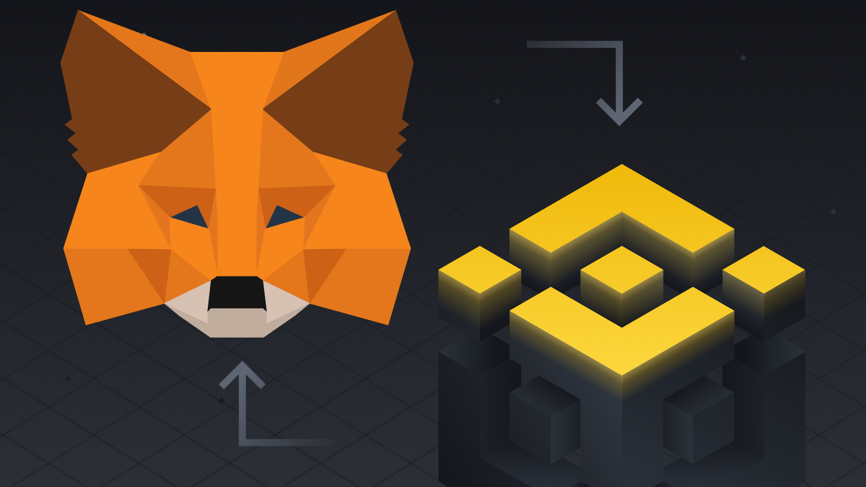

Working and Implementation
The Application uses MetaMask which acts as a database and also a means of connection between the application and local storage .
Ganache provides a real life account replica that we can use for the working of this project which helps in transacting and storing information

Slide 4
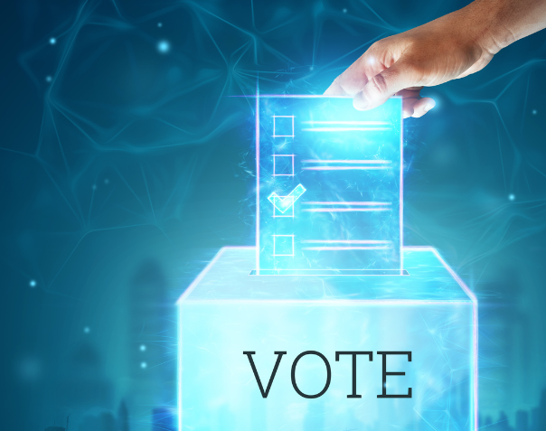
Information and Data Storage
Most of the data is stored in the form of transactions in both MetaMask and Ganache. Each and every activity is recorded and stored as each step requires the use of ETH currency.
Both the wallets ( user and admin) can be used as a proof of transactions and actions. Also there will one wallet connected per voter and no wallet can carry out the same transaction twice i.e Voter can cast a vote to a single representative only a single time.

Slide 5
Benefits over Traditional Voting
Transparency and Trust: The blockchain voting system provides a transparent and immutable ledger
Enhanced Security: Blockchain technology employs robust cryptographic algorithms to secure the voting data.
Increased Accessibility: The blockchain voting system can enhance accessibility for voters, especially those who face geographical, physical, or time constraints.
Integrity and Auditability: With a blockchain-based voting system, the entire voting process becomes auditable and traceable
Elimination of Intermediaries: Traditional voting processes often involve intermediaries such as election officials or third-party auditors

Slide 6
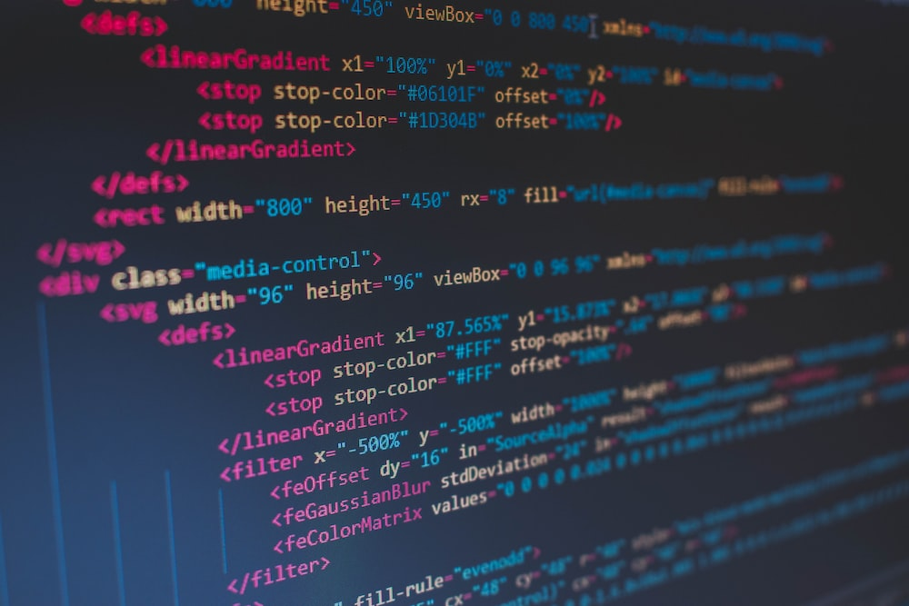
Future Enhancements
Improved Scalability
Enhanced Privacy Features
Mobile Application Development
Integration with Digital Identity Systems
Auditing and Verification Tools
Integration with External Voting Systems
Integration with Blockchain Oracles

Slide 7


Limitations
Scalability: Blockchain technology, especially public blockchains, can face scalability challenges when it comes to process
Security Risks: It is not entirely immune to security risks.ng a large number of transactions.
Legal and Regulatory Compliance: Blockchain voting systems must comply with existing legal and regulatory frameworks, which can vary from one jurisdiction to a no Cost and Infrastructure
Requirements: Implementing a blockchain voting system may involve significant costs, including infrastructure setup, maintenance, and blockchain network fees.

Slide 8
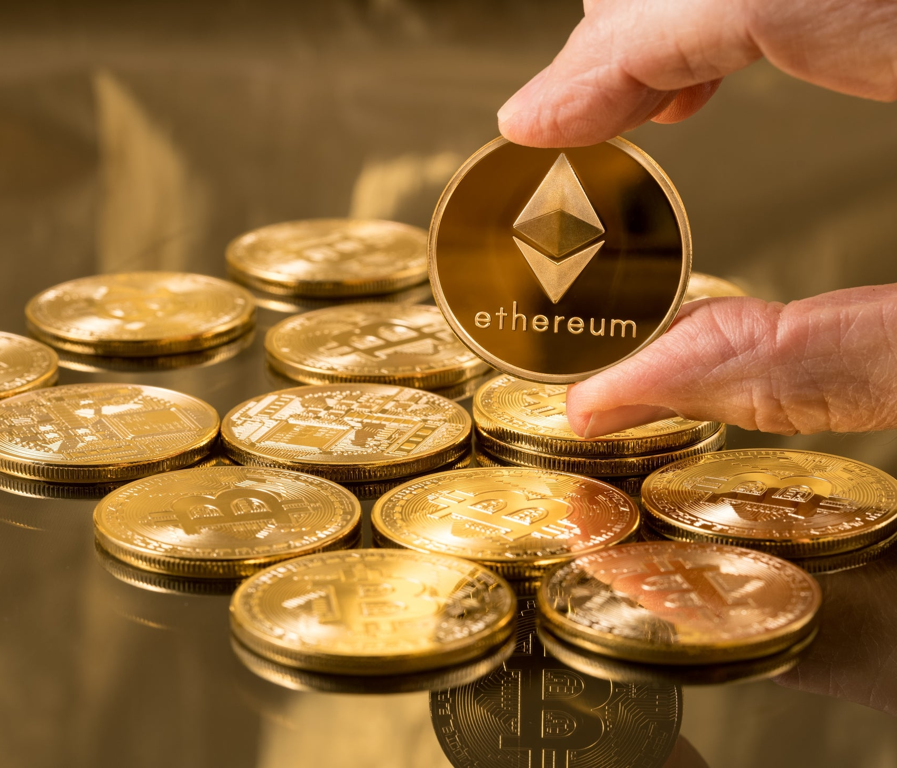

Conclusion
In conclusion, the development of a blockchain voting system using Ganache Truffle and Metamask holds great potential for revolutionizing the electoral process. The project focuses on leveraging the benefits of blockchain technology, such as transparency, immutability, and decentralized consensus, to enhance the integrity and efficiency of voting systems.

Slide 9
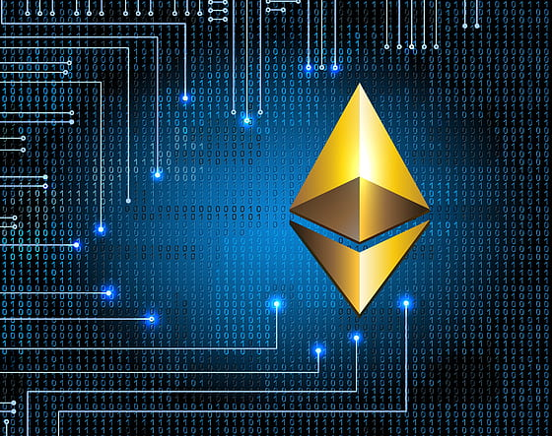
Thank You

